Slide 1



VLAN DESIGN WITH CISCO INFRASTRUCTURE
TEAMMATES:
2010030490 KAJJAMVARUNKRISHNA
2010030494 SHASHIKANTH
2010030468 SATWIK
2010030463 M.ANIL KUMAR

Slide 2
TABLE OF CONTENTS
ABSTRACT
INTRODUCTION
METHODOLOGY
FLOWCHART
GITHUB COMMITS
IMPLIMENTATION

Slide 3
ABSTRACT :
The project understands how to create different IP networks , map it with respective vlans, the actual configurations which are required on Cisco routers and switch to setup a VLAN based,
Infrastructure and allow communication between VLANs. The IP address settings which are required on the TCP/IP adapter for the users computers are also understood.
It is aimed at implementing the method LAN-Switching using VLAN to break up broadcast domains into segments, so as to improve network performance. It additionally makes educating simpler, understudies and instructor can make their own particular situation based labs also, gives genuine reproduced and representation environment cisco packet tracer has part of components to make different situation based labs. The discoveries of this study reason that there are different advantages and focal points of utilizing a cisco packet trace part of learning fundamental and critical ideas of configuration and reproduction virtual local area network. It is a simple and easy to use device to comprehend different ideas of computer networks.

Slide 4
INTRODUCTION :
Network designs, encompasses all areas of human enterprise. We find networks in the home, marketplace, offices and schools making it possible for resources to be shared in a consolidated platform. Networking plays a critical role in business performance of any organization. Efficiency and communication is guaranteed in a well-designed network .The network based on TCP/IP protocol permits the efficient routing of data packets based on their IP address.
Most of the Organizations such as public and private sectors have started deploying computers to there employees to perform their daily work and access resources from their network.
VLAN is one of the security mechanisms that can solve the authentication problem. VLANs also offer network operators flexibility for specifying management and security policies within an enterprise and allow operators to implement some level of isolation by separating hosts into different broadcast domains.
VLANs can help reduce network traffic by forming multiple broadcast domains, to break up a large network into smaller independent Segments with fewer broadcasts being sent to every device on the overall network.

Slide 5
METHODOLOGY
Basically we have three IMPORTANT types in VLAN , in our architecture
Port-Based VLAN
Protocol Based VLAN
MAC Based VLAN
This methods of VLAN in cisco architecture is very simple and easy to understand.
ACCESS POINT CONFIGURATION
BRIDGE CONFIGURATION

Slide 6
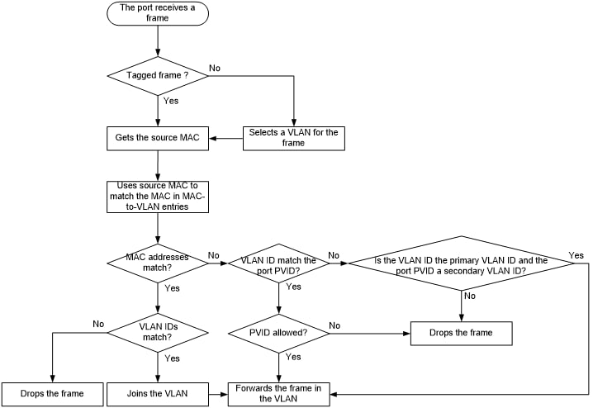
FLOW-CHART

Slide 7
GITHUB-COMMITS

Slide 8
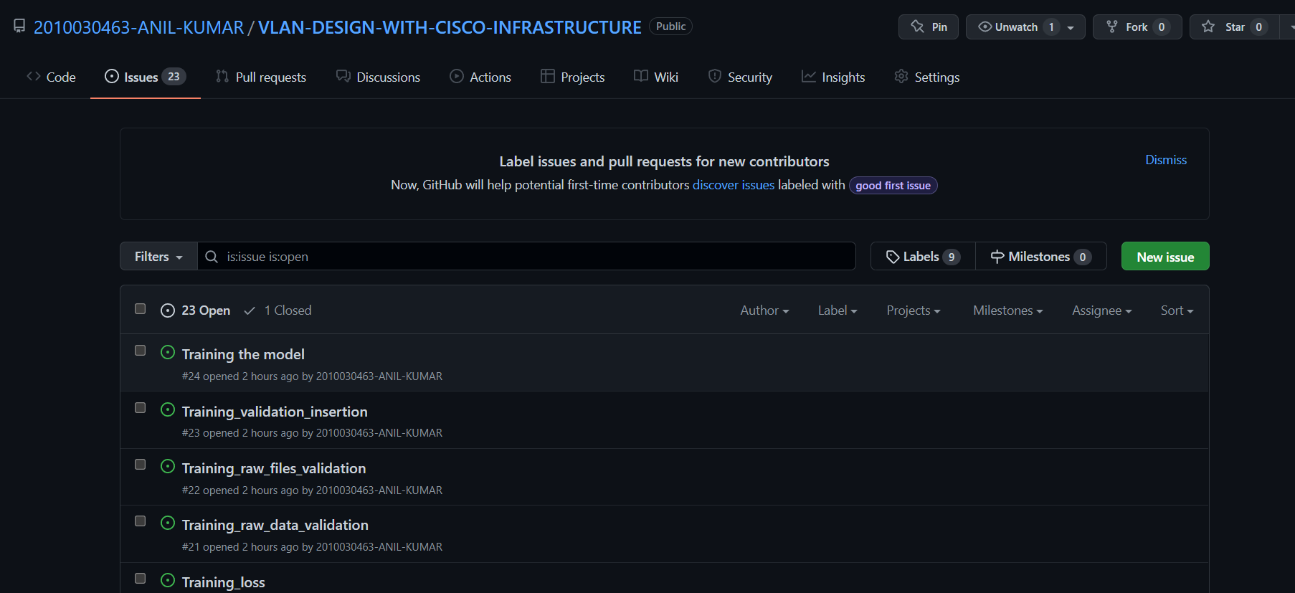


Slide 9
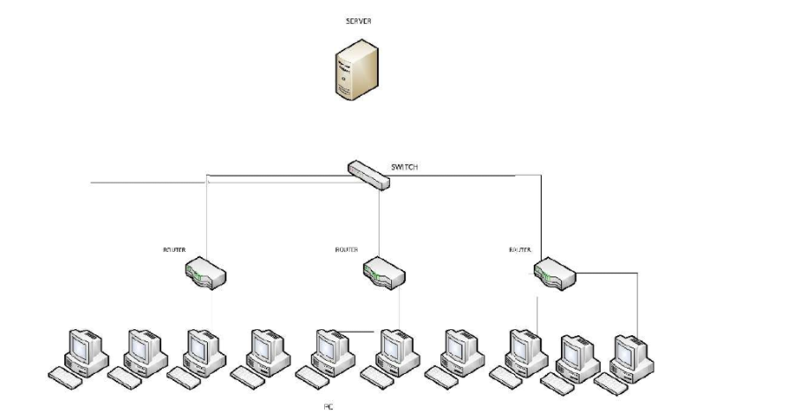
IMPLEMENTATION

Slide 10
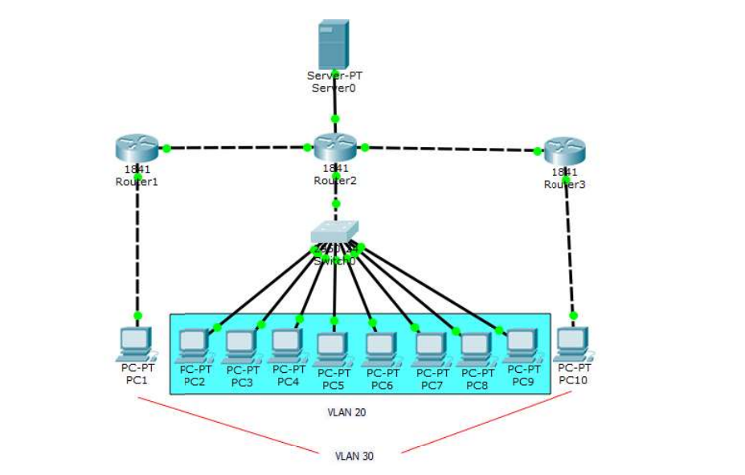
PROPOSED RECOMMENDATION NETWORK TOPOLOGY

Slide 11
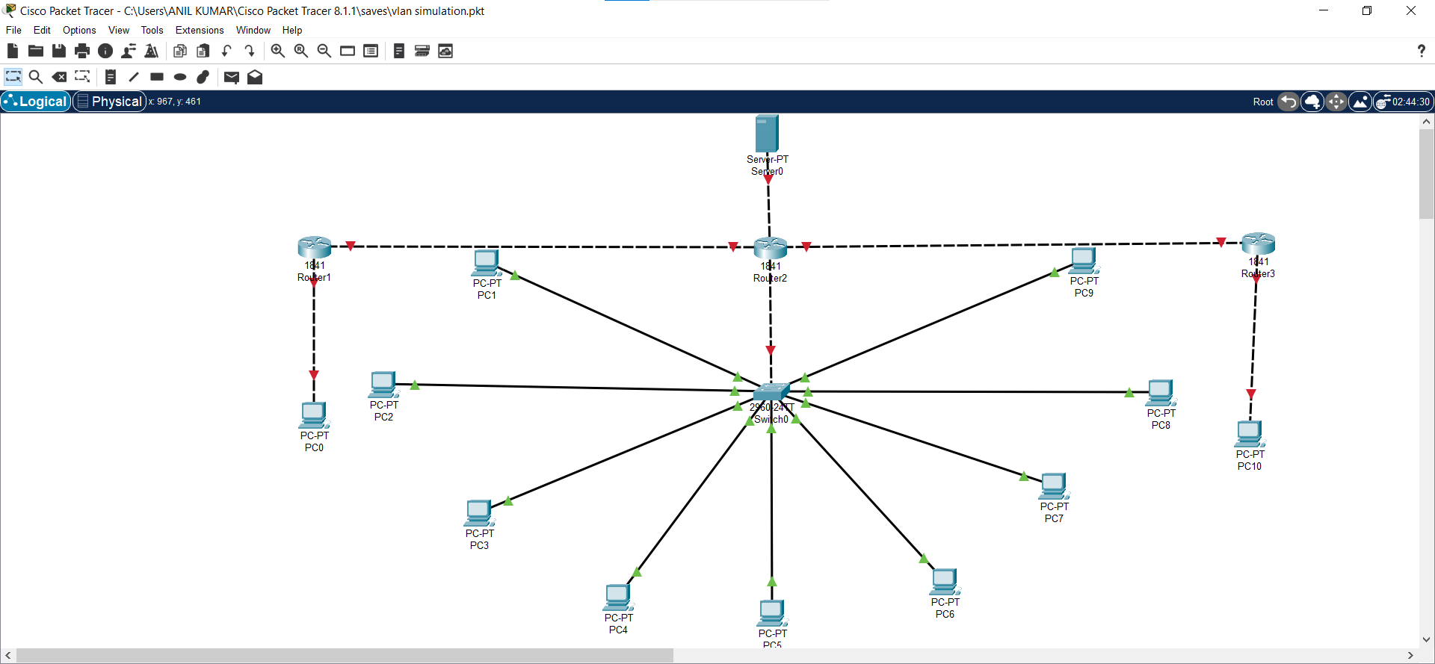
ALPHA TESTING

Slide 12
THANK YOU

